Slide 1
Rice SEED Classification (jasmine & gonen) using Machine learning
Assigned by : presented by:
Aravind Reddy K . Praveen Vardhan Raju
M . Sushmitha

Slide 2
Context
Abstract
Introduction
Exploratory Data analysis
Machine Learning Approaches
Results
Conclusion

Slide 3
Abstract
The classification process employs various machine learning techniques, including decision trees, support vector machines, and ensemble methods, It is used to identify patterns and relationships within the data. By training the model on labeled rice samples, the system learns to distinguish between different rice types. It is providing reliable predictions for unseen data.
The successful implementation of this rice classification system promises to enhance the efficiency of the rice supply chain, improve product quality assessment

Slide 4
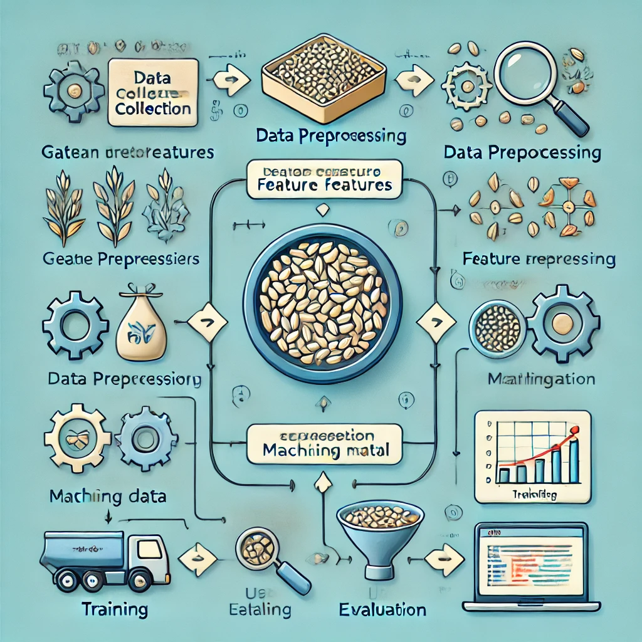
Introduction
This project is to classify rice grains based on their physical characteristics using machine learning techniques

Slide 5
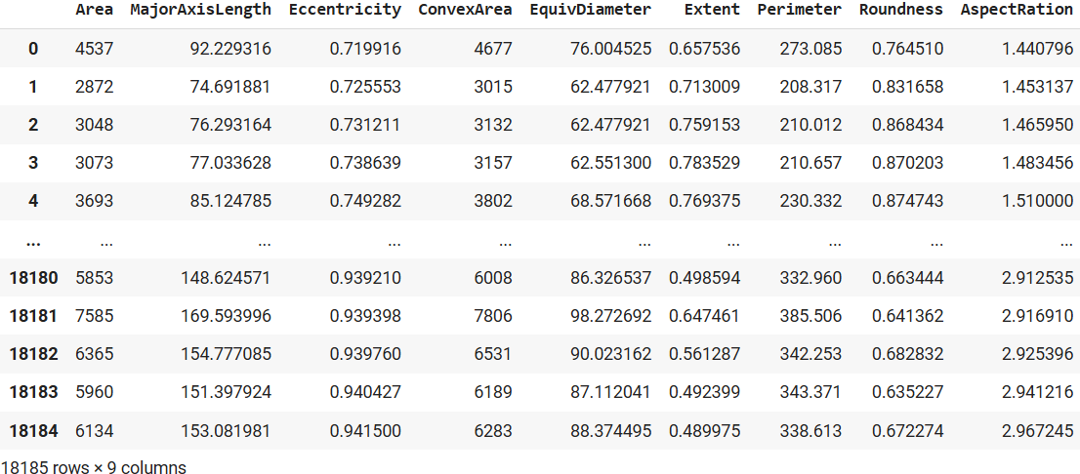

Slide 6
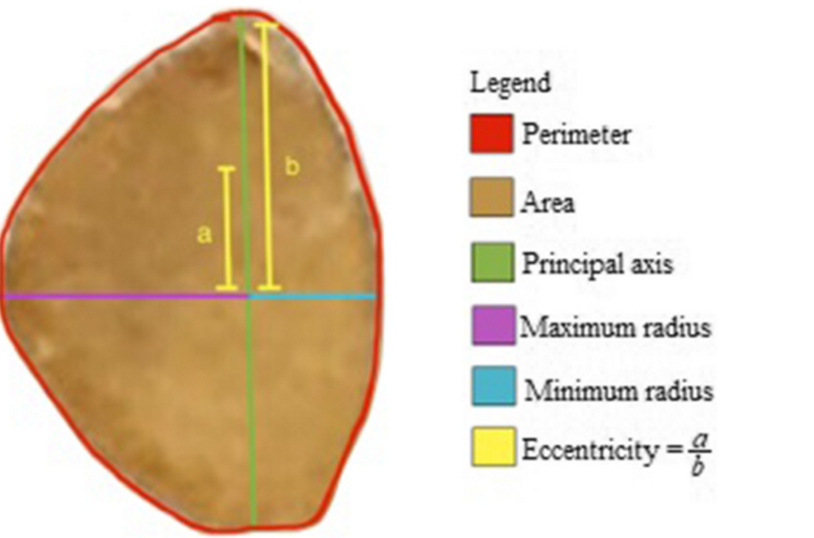

Slide 7
Exploratory Data Analysis
.
.
y.
Is a critical step in the data analysis process that involves examining and visualizing data to understand its main characteristics.
Null values : Identify missing values by using functions like .isnull().sum()
Outliers : Once outliers are detected, you can either remove them, transform them, or adjust your analysis to handle them.
Feature Selection : Improves Model Performance by using only the most important features, models become more accurate and efficient.
Visualization : Python provides powerful libraries like Matplotlib and Seaborn for creating these visualizations.

Slide 8
Machine Learning Approaches
Supervised learning is the core approach used in this project to classify different varieties of rice based on their physical and chemical attributes.
The model is trained using labeled data, where each sample is associated with a known rice variety (the target label).
Best SVM(GridSearchCV)
AdaBoost
Decision Tree
Random Forest

Slide 9
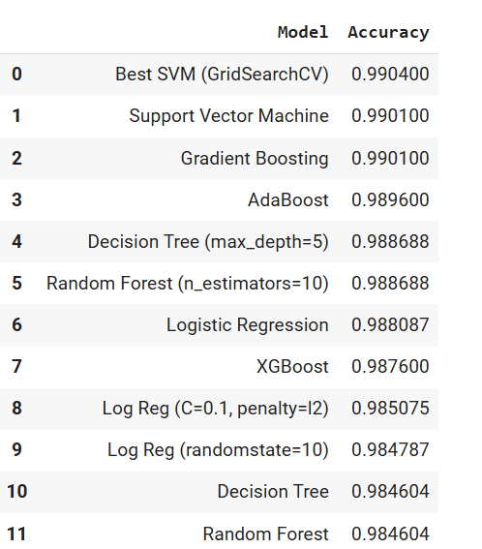

Slide 10
Result
SVM(Grid Search CV) Hyperparameter, with the highest accuracy of 0.9904, indicating its superior performance in classifying rice correctly.
Model accuracy score with default hyperparameters: 0.9904
AdaBoost and Decision Tree (max_depth=5), along with Random Forest (n_estimators=10), showed competitive results with accuracies around 0.989300.
training score: 1.0 testing score: 0.9895527859237536 Accuracy of RandomForest Reg is: 0.9842375366568915
training score: 1.0 testing score: 0.9842375366568915 Accuracy of DecisionTree Reg is: 0.9842375366568915

Slide 11
Applications
Price Differentiation in Markets
Inventory Management for Rice Suppliers
Agricultural Research and Breeding Programs
Quality Control in Rice Processing
Rice Variety Differentiation for Export and Trade

Slide 12
Conclusion
The evaluation of various machine learning models for rice classification demonstrates that all models perform exceptionally well, with accuracies ranging between 98% and 99%.
The consistency in performance across different models, along with the minimal difference (±3%) between training and test accuracies, indicates that the models are not overfitted.
The SVM(Grid Search CV) Hyperparameter, with the highest accuracy of 0.9904, stands out as the most effective model for this task.

Slide 13


